Slide 1

IPL Cricket Match Outcome Prediction Using AI Techniques
overall_1_132505419578873737 columns_1_132505419578873737
Presented By: Jerryl Davis
Authors: Narayana Darapaneni Rajesh Goel Amit Bhatia Pulkit Malhotra Harsh Bhardwaj Vikas Hooda
Special Thanks: Anwesh Reddy Paduri Affiliations: Great Learning

Slide 2
Problem Definition
overall_1_132505424119245480 columns_1_132505424119245480
Predicting outcome of the IPL Cricket Match
by using BALL by BALL prediction during the 2nd inning.

Slide 3
What's already there and where is the gap?
overall_1_132505418264875031 columns_1_132505418264875031
In most research papers we have found accuracy around 50% whereas we have been able to achieve accuracy close to 78%.
Major difference in our approach is that we have used ball by ball prediction during the 2nd innings of each match whereas others have used 1 prediction for the entire match.
In another research we analyzed there are factors like winning of a toss , weather conditions, batting first, fielding first and home ground plays an important role in winning.
Our Uniqueness
LSTM (with ball by ball prediction) used for first time to predict the cricket match outcome.
Using the features in the generic fashion
Ball by Ball Betting introduction in match
Notes:
Harsh Bhardwaj
1.

Slide 4
Data Sources
overall_1_132505419147674558 columns_1_132505419147674558
Data Collection
Data set from different sources were examined for this study.
Data set for all IPL matches(Season 2008-2017) were considered for this project work.
Total 792 matches were considered for this study.
Pre-processing
Data cleaning (filtered out highly correlated attributes).
Feature engineering of the data ball by ball for each match manually.
Automated this process by making macros to speed up this process
(~70.0% time efficient)
Notes:
Harsh Bhardwaj – Intro
Amit – Data Description and EDA in Detail

Slide 5
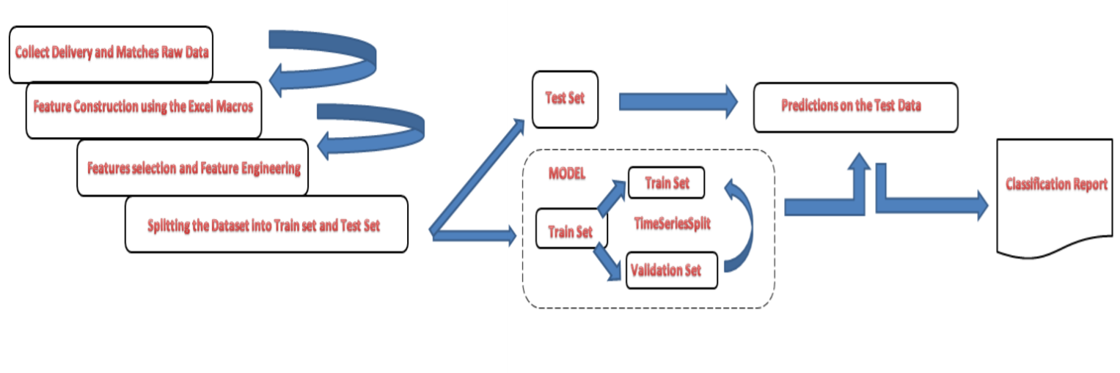
Product High Level Architecture with Feature Engineering
overall_1_132505418401594956 columns_1_132505418401594956
Data Preparation
(Preparing Ball by ball data set for all matches)
Feature Engineering
(Dropping off parameters which are not relevant.)
Train/Test Data split
Model Building using deep learning
(LSTM and GRU)
Model Training
(Ball by ball prediction)
Model Evaluation (Ball by Ball prediction for every 5 overs during 2nd innings)
Notes:
Vikas

Slide 6
Result Analysis and Comparisons Traditional Machine Learning Models
overall_1_132328931320904917 columns_1_132328931320904917
Notes:
Jerryl

Slide 7
Next Big Question How we can do better ? Which techniques or Algorithms can be used to achieve more higher accuracies ?
overall_1_132505418402462628 columns_1_132505418402462628

Slide 8
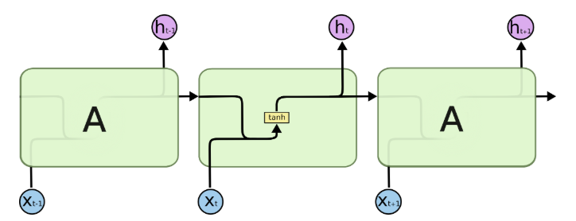
Architectures of models – Vanilla LSTM
overall_1_132328924943717459 columns_1_132328924943717459
Long Short Term Memory networks – usually just called “LSTMs” – are a special kind of RNN, capable of learning long-term dependencies.
They were introduced by Hochreiter & Schmidhuber (1997), and were refined and popularized by many people in following work.
They work tremendously well on a large variety of problems, and are now widely used.
LSTMs are explicitly designed to avoid the long-term dependency problem.
Remembering information for long periods of time is practically their default behavior, not something they struggle to learn.
In standard RNNs, this repeating module will have a very simple structure, such as a single tanh layer.
LSTMs also have this chain like structure, but the repeating module has a different structure.
Instead of having a single neural network layer, there are four, interacting in a very special way.
Source: https://colah.github.io/posts/2015-08-Understanding-LSTMs/

Slide 9
Results Analysis and Comparisons LSTM and GRU
overall_1_132328931330608984 columns_1_132328931330608984
MODEL NAME | TRAIN ACCURACY | TEST ACCURACY
LSTM | 80.52 | 74.57
GRU | 80.69 | 73.76
Notes:
Rajesh

Slide 10
Results Analysis and Comparisons LSTM and GRU, Over by Over
overall_1_132328931330608984 columns_1_132328931330608984
OVER | LSTM | GRU
1-5 | 0.65 | 0.65
6-10 | 0.68 | 0.69
11-15 | 0.77 | 0.78
16-20 | 0.77 | 0.76
Notes:
Rajesh

Slide 11
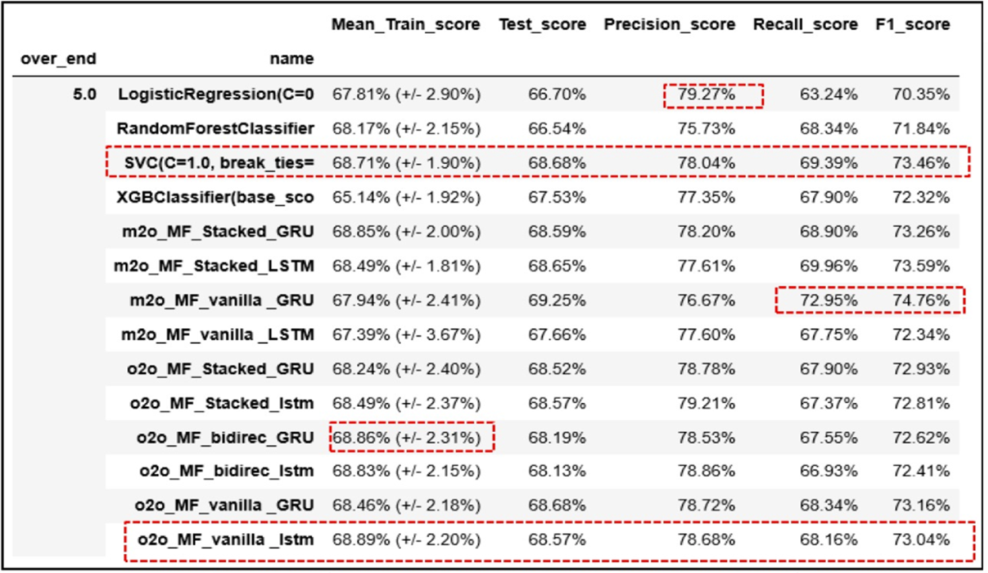
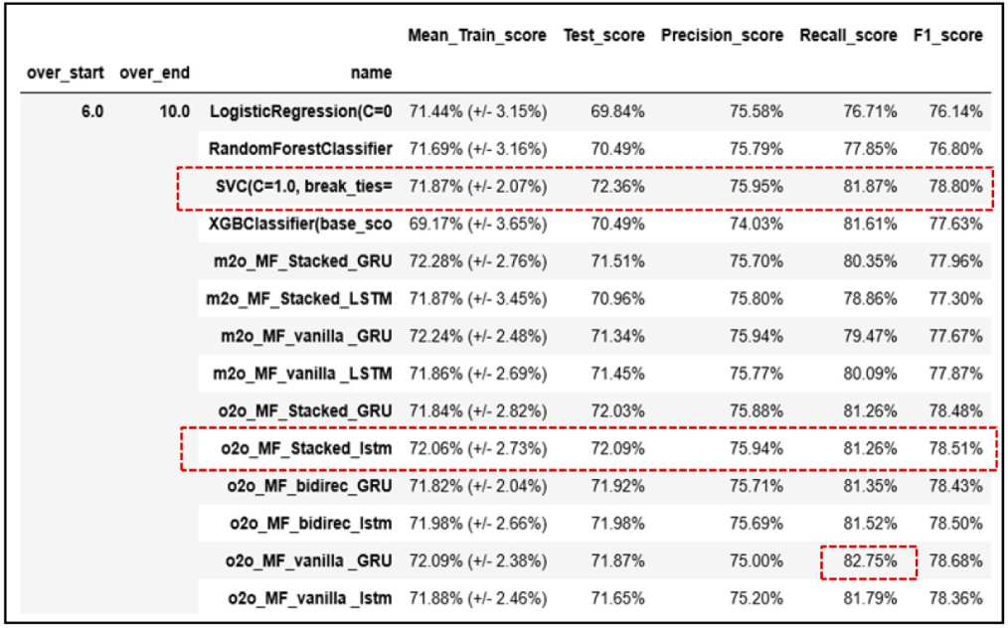
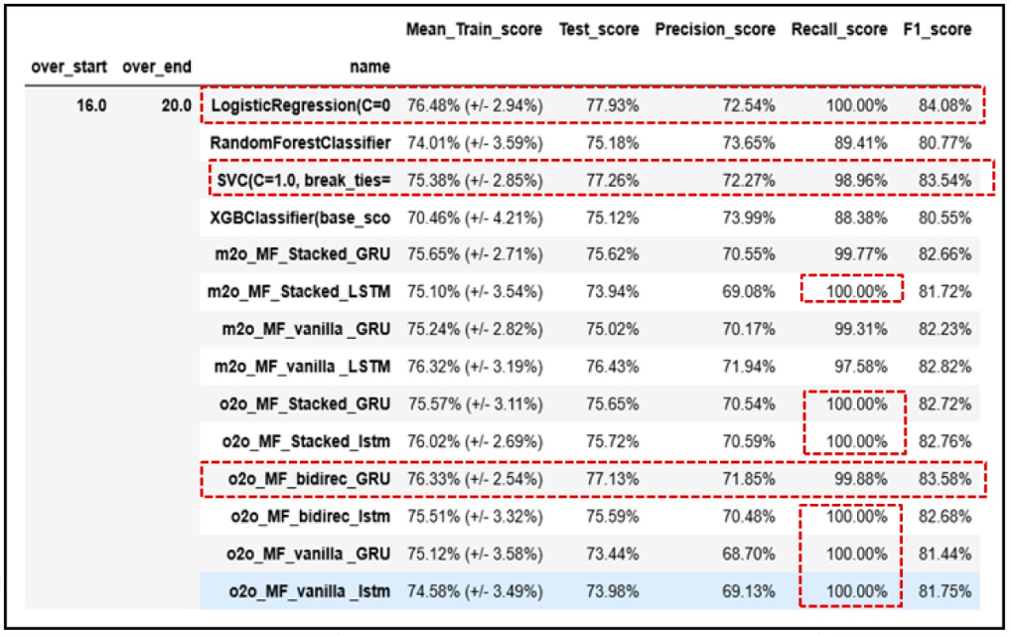
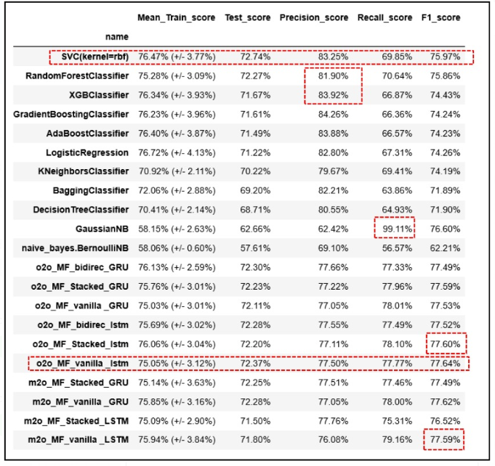
Implementation of Different flavours of LSTM -GRU
overall_1_132505427669353304 columns_1_132505427669353304

Slide 12
Future Work
overall_1_132505427194606418 columns_1_132505427194606418
The model can be further enhanced by putting more attributes for e.g., venues, off the field attributes, including player stats etc.
Real time prediction of live matches can be integrated with the model.
In future we also intend to build a recommendation model which can suggest during the second innings as to which player is best suited to play during the specific situation during the match.

Slide 13
Minimum Viable Product
overall_1_132505426711125859 columns_1_132505426711125859
Win Meter
Player Selection and placements on situational parameters
Coach ka Coach App , Captain ka Captain App
6 – 12 Months
Resource and capital Investment
Two domain Experts , Two Data Engineers , One Data Architect / Lead, One Sales and BD Head
Required Data Set
INR 1.5 Cr – 2 Cr

Slide 14
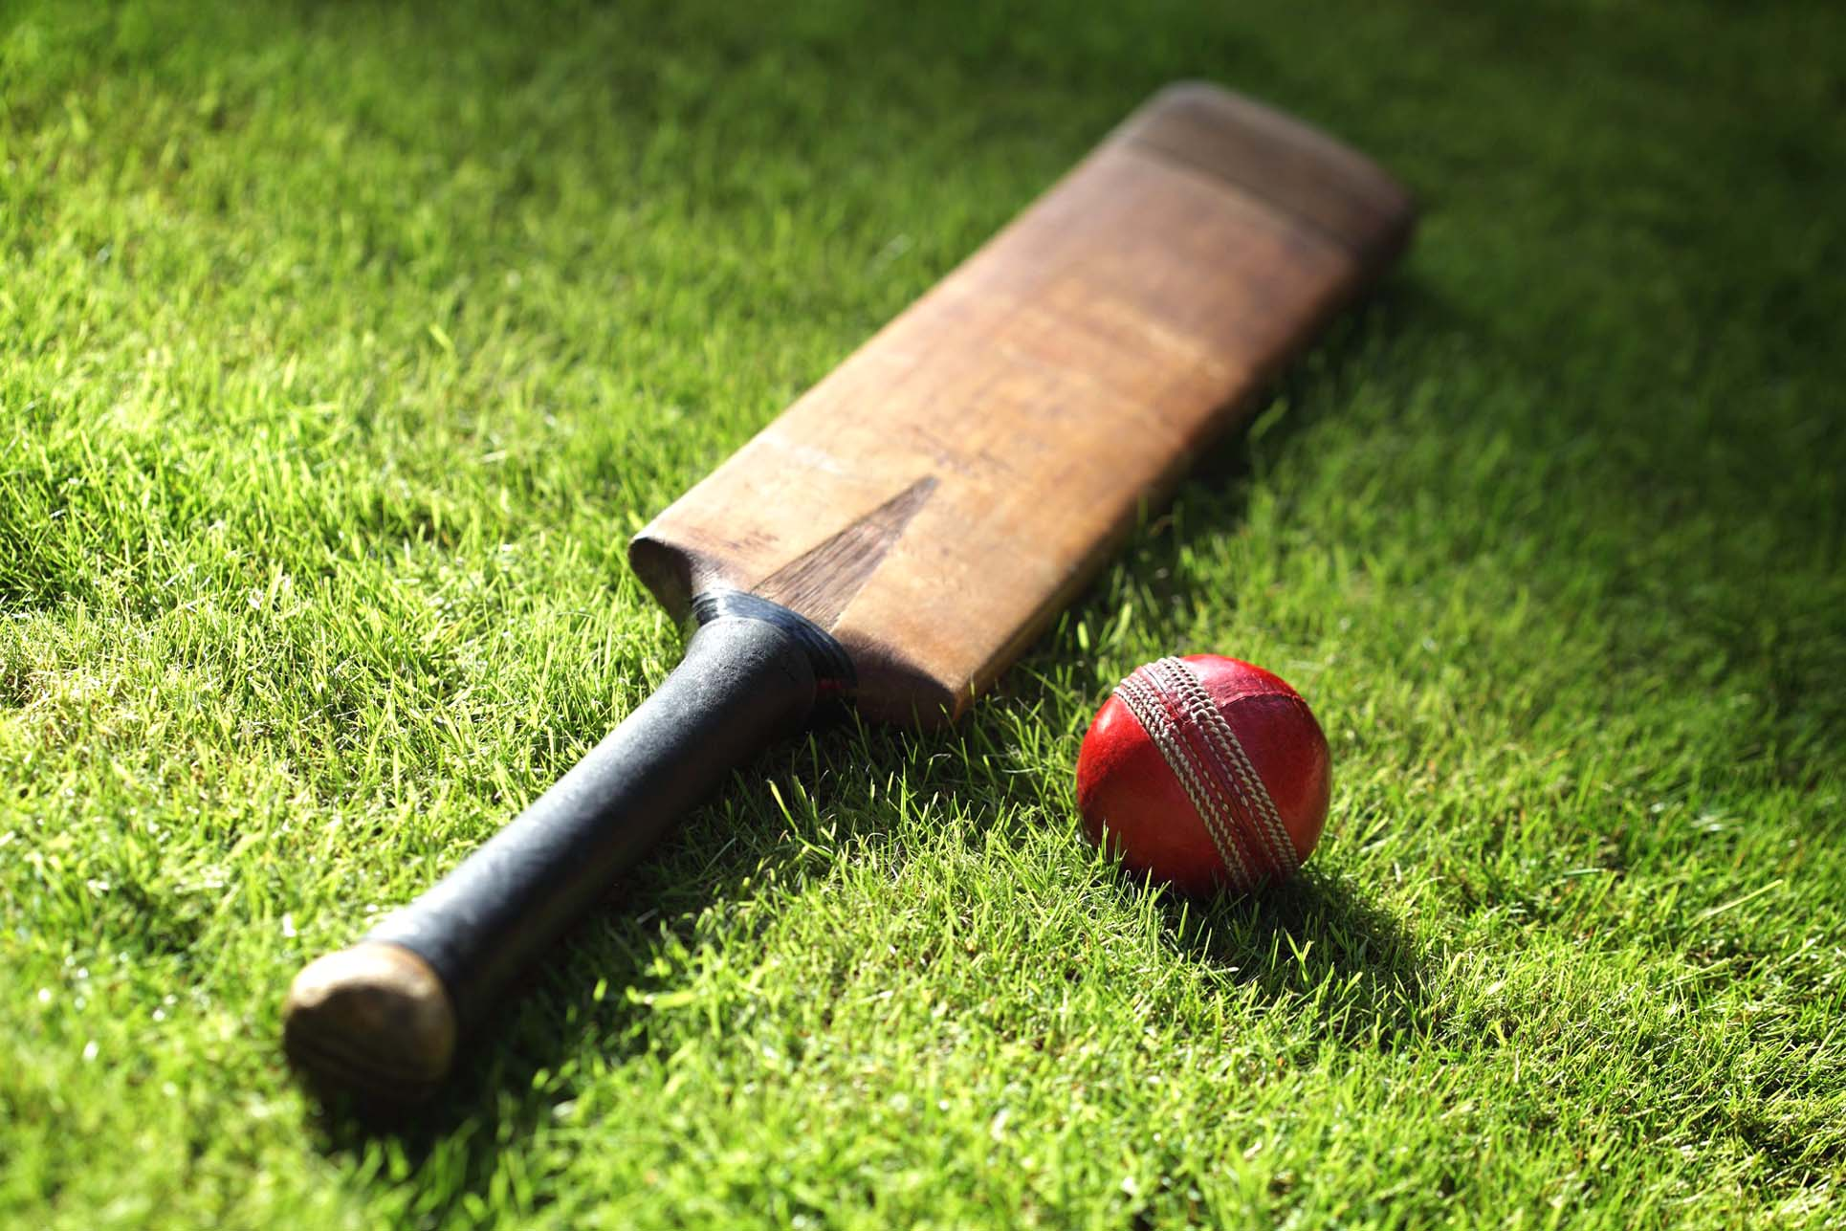

overall_1_132505426706818335 columns_1_132505426706818335
JERRYL DAVIS
AMIT BHATIA
RAJESH GOEL
PULKIT MALHOTRA
HARSH BHARDWAJ
VIKAS HOODA

